Slide 1

Hello, today I will show you how step by step you can find inverse kinematic of a QUADRUPED SPIDER ROBOT

Slide 2

SO, have a coffee or glass of water and let’s start.

Slide 3
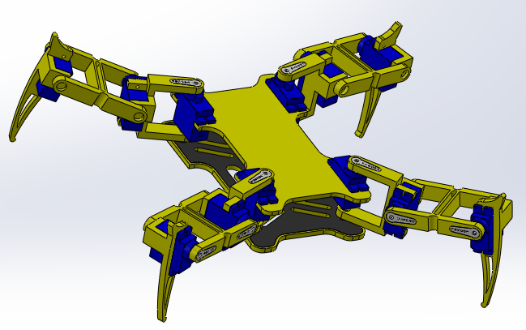

First let me show you how the robot looks in 3D Modeling.

Slide 4
Looks nice. Isn’t it?
See, the robot has four legs but we will focus on only one and find the inverse kinematic apply to that leg.

Slide 5
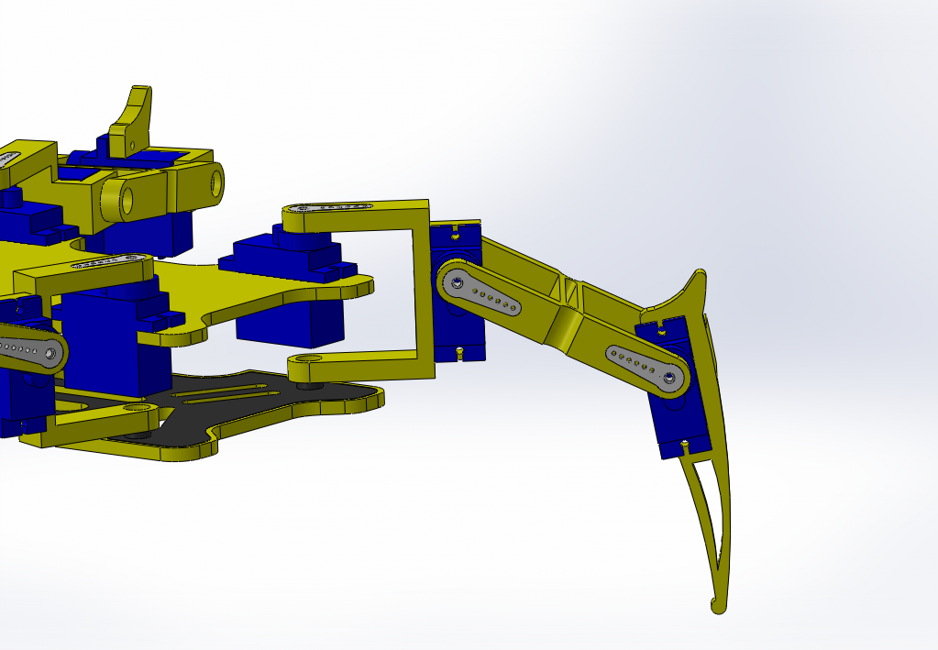
This is the leg we selected randomly

Slide 6

In other to find our inverse Kinematic, we have to look the top view and side view of the robot leg.

Slide 7
We start with the top view

Slide 8
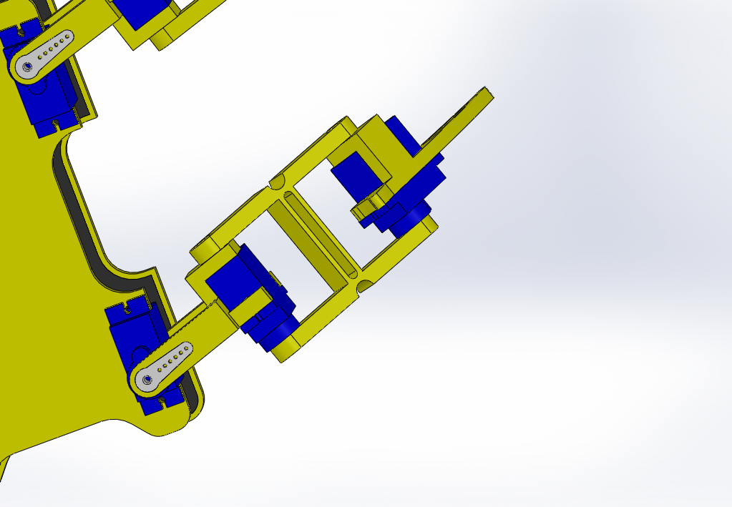

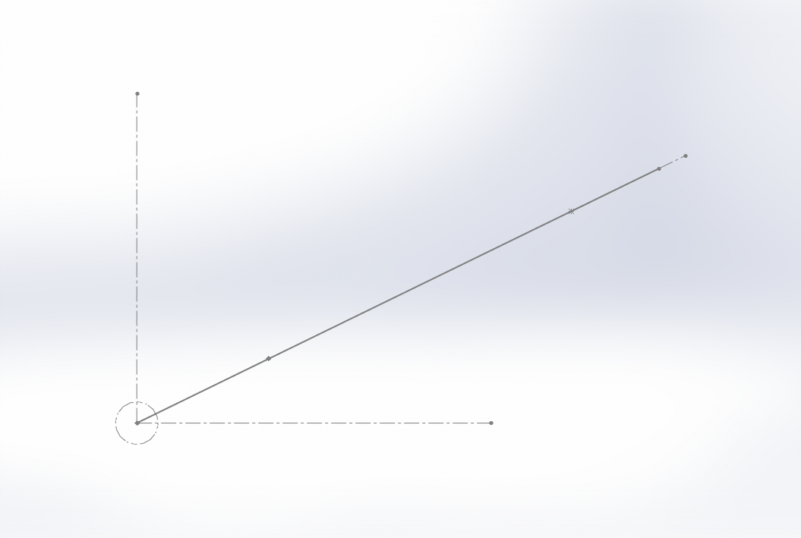
TOP VIEW OF ONE LEG ROBOT
J₁, J₂ and J₃ represent the joints of the robot leg, where rotations will take place.
J₃
J₂
J₁

Slide 9


TOP VIEW OF ONE LEG ROBOT
$$P\left[\begin{aligned}&X \\ &Y \\ &Z\end{aligned}\right]$$
J₃
J₂
J₁
We assume $P\left[\begin{aligned}&X \\ &Y \\ &Z\end{aligned}\right]$ cartesian coordinate, the location of the end leg from J₁

Slide 10
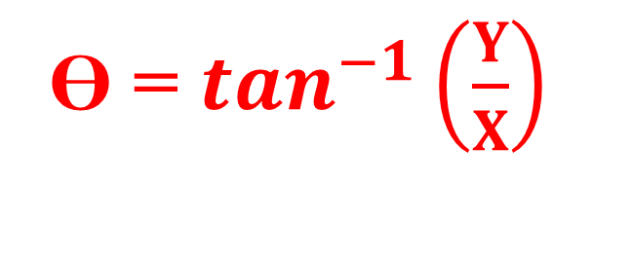

TOP VIEW OF ONE LEG ROBOT
We have a right triangle. So it is easy to find ϴ, Wich is the angle rotation at J₁
$$P\left[\begin{aligned}&X \\ &Y \\ &Z\end{aligned}\right]$$
ϴ = $\tan^{−1}\left(\frac{Y}{X}\right)$
J₃
Y
J₂
ϴ
J₁
X

Slide 11
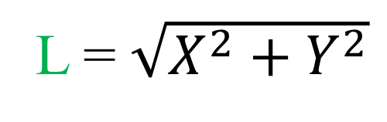
TOP VIEW OF ONE LEG ROBOT
$$P\left[\begin{aligned}&X \\ &Y \\ &Z\end{aligned}\right]$$
L is the leg length projection in the xy plan.
L = $\sqrt{X^{2}+Y^{2}}$
J₃
L
Y
J₂
ϴ
J₁
X

Slide 12

Now, we move to the most challenging part which is the side view

Slide 13
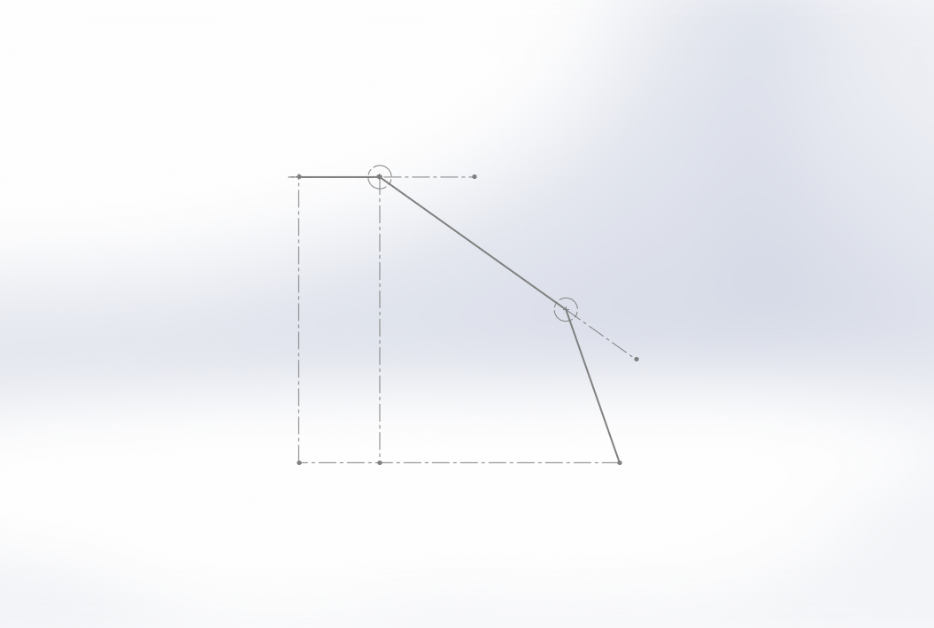

Side view of one leg Robot
J₁
J₂
J₃
$$P\left[\begin{aligned}&X \\ &Y \\ &Z\end{aligned}\right]$$

Slide 14

Side view of one leg Robot
α, β are rotation angles respectively to J₂, J₃. Now we have to found the relation with X,Y,Z coordinates.
Lc: Distance from J₁ to J₂
Lf: Distance from J₂ to J₃
Lt: Distance from J₃ to end of the leg
J₁
J₂
Z: Distance from J₁ to end of the leg on the z axis direction
α
Lc
Lf
J₃
Z
β
Lt
$$P\left[\begin{aligned}&X \\ &Y \\ &Z\end{aligned}\right]$$
L

Slide 15

Side view of one leg Robot
Lc: Distance from J₁ to J₂
Lf: Distance from J₂ to J₃
How to start solving??
Lt: Distance from J₃ to end of the leg
J₁
J₂
Z: Distance from J₁ to end of the leg on the z axis direction
α
Lc
Lf
J₃
Z
β
Lt
$$P\left[\begin{aligned}&X \\ &Y \\ &Z\end{aligned}\right]$$
L

Slide 16

Side view of one leg Robot
We will focus on the two right triangles in order to complete the inverse kinematic problem.
J₁
J₂
α
Lc
Lf
J₃
Z
β
Lt
$$P\left[\begin{aligned}&X \\ &Y \\ &Z\end{aligned}\right]$$
L

Slide 17
Side view of one leg Robot
A new parameter call R, which is the distance from J₂
to the end of the leg is needed
J₁
J₂
α
Lc
Lf
J₃
Z
β
Lt
R
$$P\left[\begin{aligned}&X \\ &Y \\ &Z\end{aligned}\right]$$
L

Slide 18
Side view of one leg Robot
R = -
J₁
J₂
α
Lc
Lc
Lf
J₃
Z
β
Lt
R
$$P\left[\begin{aligned}&X \\ &Y \\ &Z\end{aligned}\right]$$
L
L

Slide 19
Side view of one leg Robot
R = L - Lc
J₁
J₂
α
Lc
Lc
Lf
J₃
Z
β
Lt
R
$$P\left[\begin{aligned}&X \\ &Y \\ &Z\end{aligned}\right]$$
L
L

Slide 20

Side view of one leg Robot
R = L - Lc
Lf * cos(α)
At present, we are determining the measurements of all the sides of the triangles.
J₁
J₂
α
Lc
Lf
Lf * sin(α)
J₃
Z
β
Lt
R
$$P\left[\begin{aligned}&X \\ &Y \\ &Z\end{aligned}\right]$$
Lt * cos(β)
L
Lt * sin(β)

Slide 21
Side view of one leg Robot
R = L - Lc
Lf * cos(α)
The third right triangle is also important. And the side lengths of it must be find.
Lt * cos(α + β)
J₁
J₂
α
Lc
Lf
Lf * sin(α)
J₃
Z
β
Lt * sin(α + β)
Lt
R
$$P\left[\begin{aligned}&X \\ &Y \\ &Z\end{aligned}\right]$$
Lt * cos(β)
L
Lt * sin(β)

Slide 22
Side view of one leg Robot
R = L - Lc
Lf * cos(α)
Now, let’s find β. Trust me it’s easy.
Lt * cos(α + β)
J₁
J₂
α
Lc
Lf
Lf * sin(α)
J₃
Z
β
Lt * sin(α + β)
Lt
R
$$P\left[\begin{aligned}&X \\ &Y \\ &Z\end{aligned}\right]$$
Lt * cos(β)
L
Lt * sin(β)

Slide 23
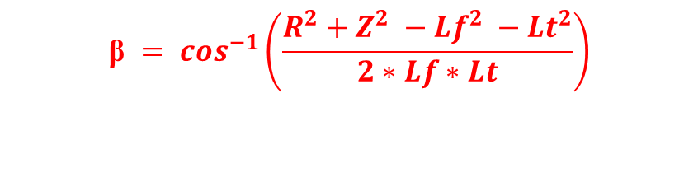
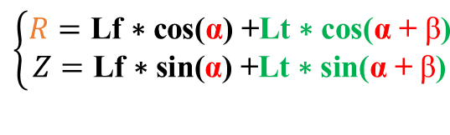
Side view of one leg Robot
R = L - Lc
Lf * cos(α)
Lt * cos(α + β)
$$\left\{\begin{aligned}R=\text{Lf}\text{ ∗ }\text{cos}\text{(}\text{α}\text{)}\text{ +}\text{Lt}\text{ ∗ }\text{cos}\text{(}\text{α}\text{ + }\text{β}\text{)} \\ Z=\text{Lf}\text{ ∗ }\text{sin}\text{(}\text{α}\text{)}\text{ +}\text{Lt}\text{ ∗ }\text{sin}\text{(}\text{α}\text{ + }\text{β}\text{)} \end{aligned}\right.$$
J₁
J₂
α
Lc
By solving $R^{2}+Z^{2}$ we find : cos($\text{β}$) = $\frac{R^{2}+Z^{2} −{Lf}^{2} −{Lt}^{2}}{2∗Lf∗Lt}$
Lf
Lf * sin(α)
J₃
Z
$$\text{β} = \cos^{−1}\left(\frac{R^{2}+Z^{2} −{Lf}^{2} −{Lt}^{2}}{2∗Lf∗Lt}\right)$$
β
Lt * sin(α + β)
Lt
R
$$P\left[\begin{aligned}&X \\ &Y \\ &Z\end{aligned}\right]$$
Lt * cos(β)
L
Lt * sin(β)

Slide 24
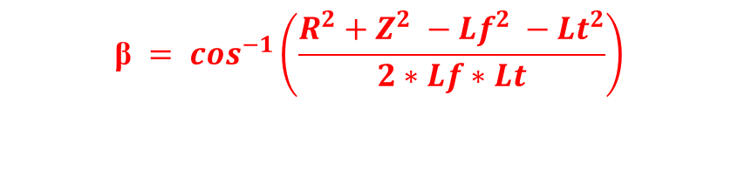
Side view of one leg Robot
R = L - Lc
Lf * cos(α)
Lt * cos(α + β)
$$\left\{\begin{aligned}R=\text{Lf}\text{ ∗ }\text{cos}\text{(}\text{α}\text{)}\text{ +}\text{Lt}\text{ ∗ }\text{cos}\text{(}\text{α}\text{ + }\text{β}\text{)} \\ Z=\text{Lf}\text{ ∗ }\text{sin}\text{(}\text{α}\text{)}\text{ +}\text{Lt}\text{ ∗ }\text{sin}\text{(}\text{α}\text{ + }\text{β}\text{)} \end{aligned}\right.$$
J₁
J₂
α
Lc
Lf
Lf * sin(α)
J₃
Z
β
Lt * sin(α + β)
By solving $R^{2}+Z^{2}$ we find : cos($\text{β}$) = $\frac{R^{2}+Z^{2} −{Lf}^{2} −{Lt}^{2}}{2∗Lf∗Lt}$
Lt
R
$$\text{β} = \cos^{−1}\left(\frac{R^{2}+Z^{2} −{Lf}^{2} −{Lt}^{2}}{2∗Lf∗Lt}\right)$$
$$P\left[\begin{aligned}&X \\ &Y \\ &Z\end{aligned}\right]$$
Lt * cos(β)
L
Lt * sin(β)

Slide 25

Now, we can move on and find the last one which is α

Slide 26

Side view of one leg Robot
R = L - Lc
$$\text{β} = \cos^{−1}\left(\frac{R^{2}+Z^{2} −{Lf}^{2} −{Lt}^{2}}{2∗Lf∗Lt}\right)$$
J₁
J₂
α
Lc
A0
$$A0{= tan}^{−1}\left(\frac{Z}{R}\right)$$
J₃
Z
R
$$P\left[\begin{aligned}&X \\ &Y \\ &Z\end{aligned}\right]$$
L

Slide 27
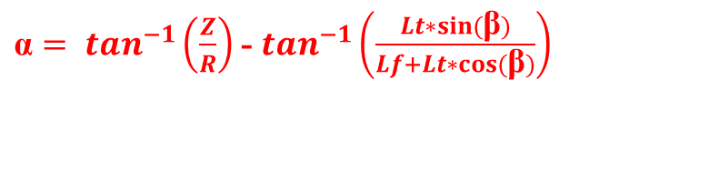
Side view of one leg Robot
R = L - Lc
$$\text{β} = \cos^{−1}\left(\frac{R^{2}+Z^{2} −{Lf}^{2} −{Lt}^{2}}{2∗Lf∗Lt}\right)$$
J₁
J₂
α
Lc
A0
Lf
$$A0{= tan}^{−1}\left(\frac{Z}{R}\right)$$
J₃
Z
A1 = $\tan^{−1}\left(\frac{Lt∗sin⁡(\text{β})}{Lf+Lt∗cos⁡(\text{β})}\right)$
A1
$$\text{α}=A0 −A1$$
R
${\text{α}= tan}^{−1}\left(\frac{Z}{R}\right)$ - $\tan^{−1}\left(\frac{Lt∗sin⁡(\text{β})}{Lf+Lt∗cos⁡(\text{β})}\right)$
$$P\left[\begin{aligned}&X \\ &Y \\ &Z\end{aligned}\right]$$
Lt * cos(β)
L
Lt * sin(β)

Slide 28
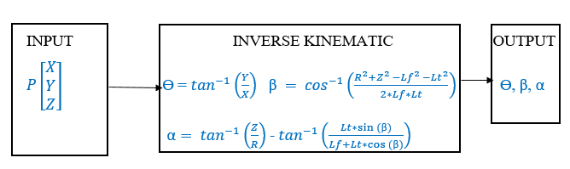


Youpi!!!! Done. Hope the explanation was clear enough.
Note: $\text{ϴ}\text{,} \text{α} \text{and} \text{β} \text{are} \text{in} \text{radian}\text{.}$

Slide 29

Please kindly leave a comment specifying which robot inverse kinematics you would like to have explained. Thank you and bye bye.

